Slide 1
Andy vangilder clay county extension staff chair Ron Baker Clay County Extension agricultural Agent
Flag The Technology

Slide 2
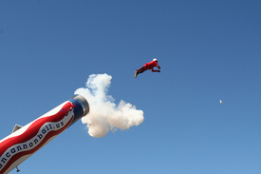
Farming Is A High Risk Business
98% Family Farms
1950:12.2% of U.S. Population
2012: .7% of U.S. Population

Slide 3
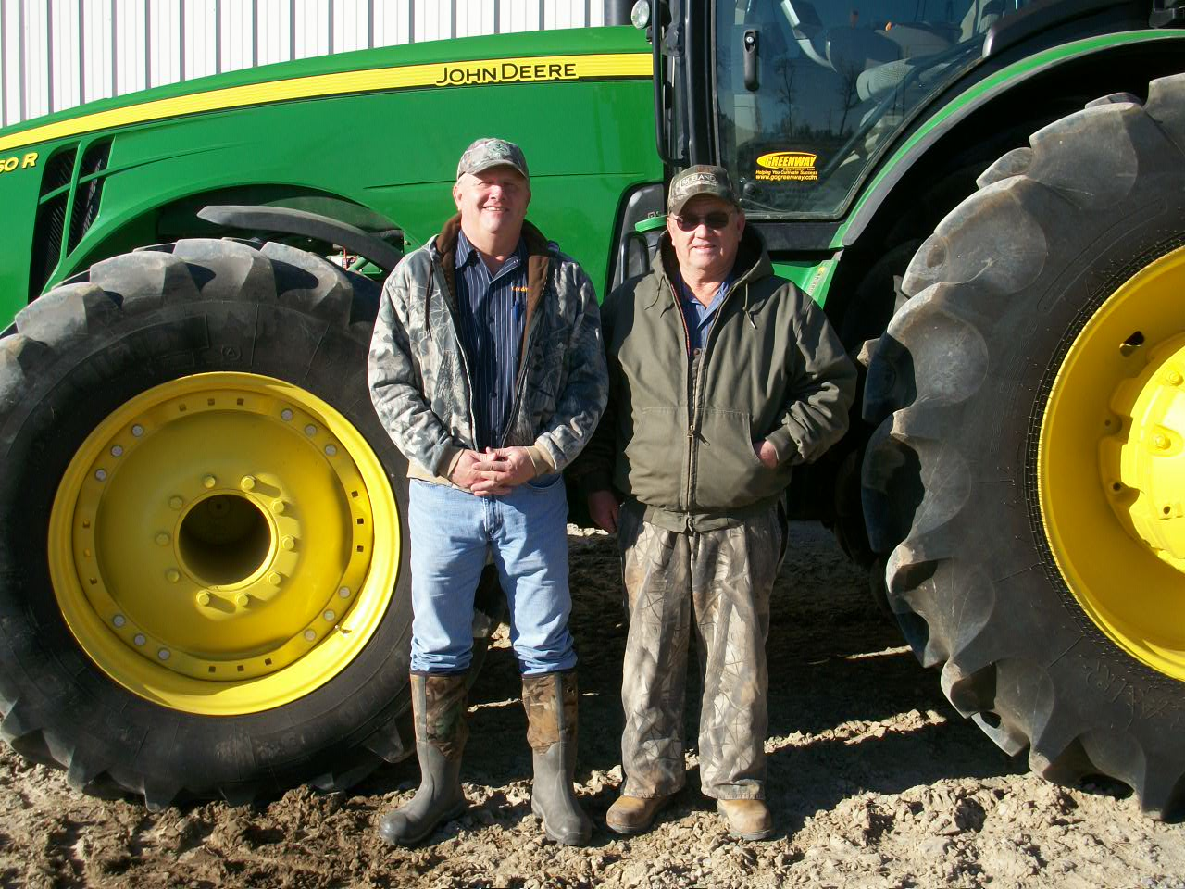
Vanishing Species!

Slide 4
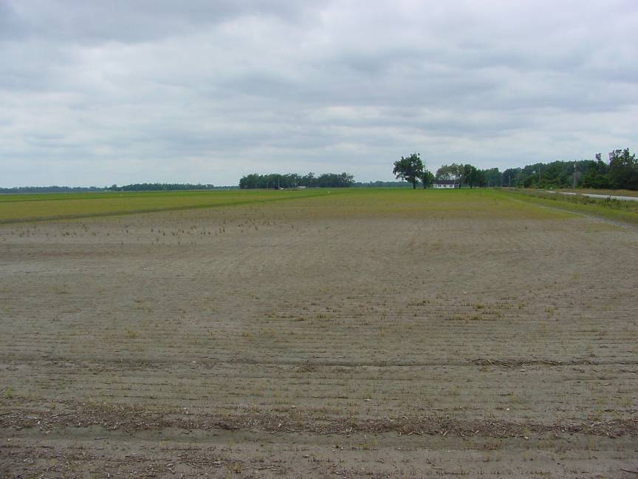
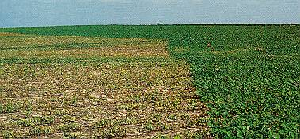
Herbicide Mistakes
(Off Target Drift and Misapplications)
Destroy Crops
Often Ruin Community Relationship
Increasingly Problematic

Slide 5
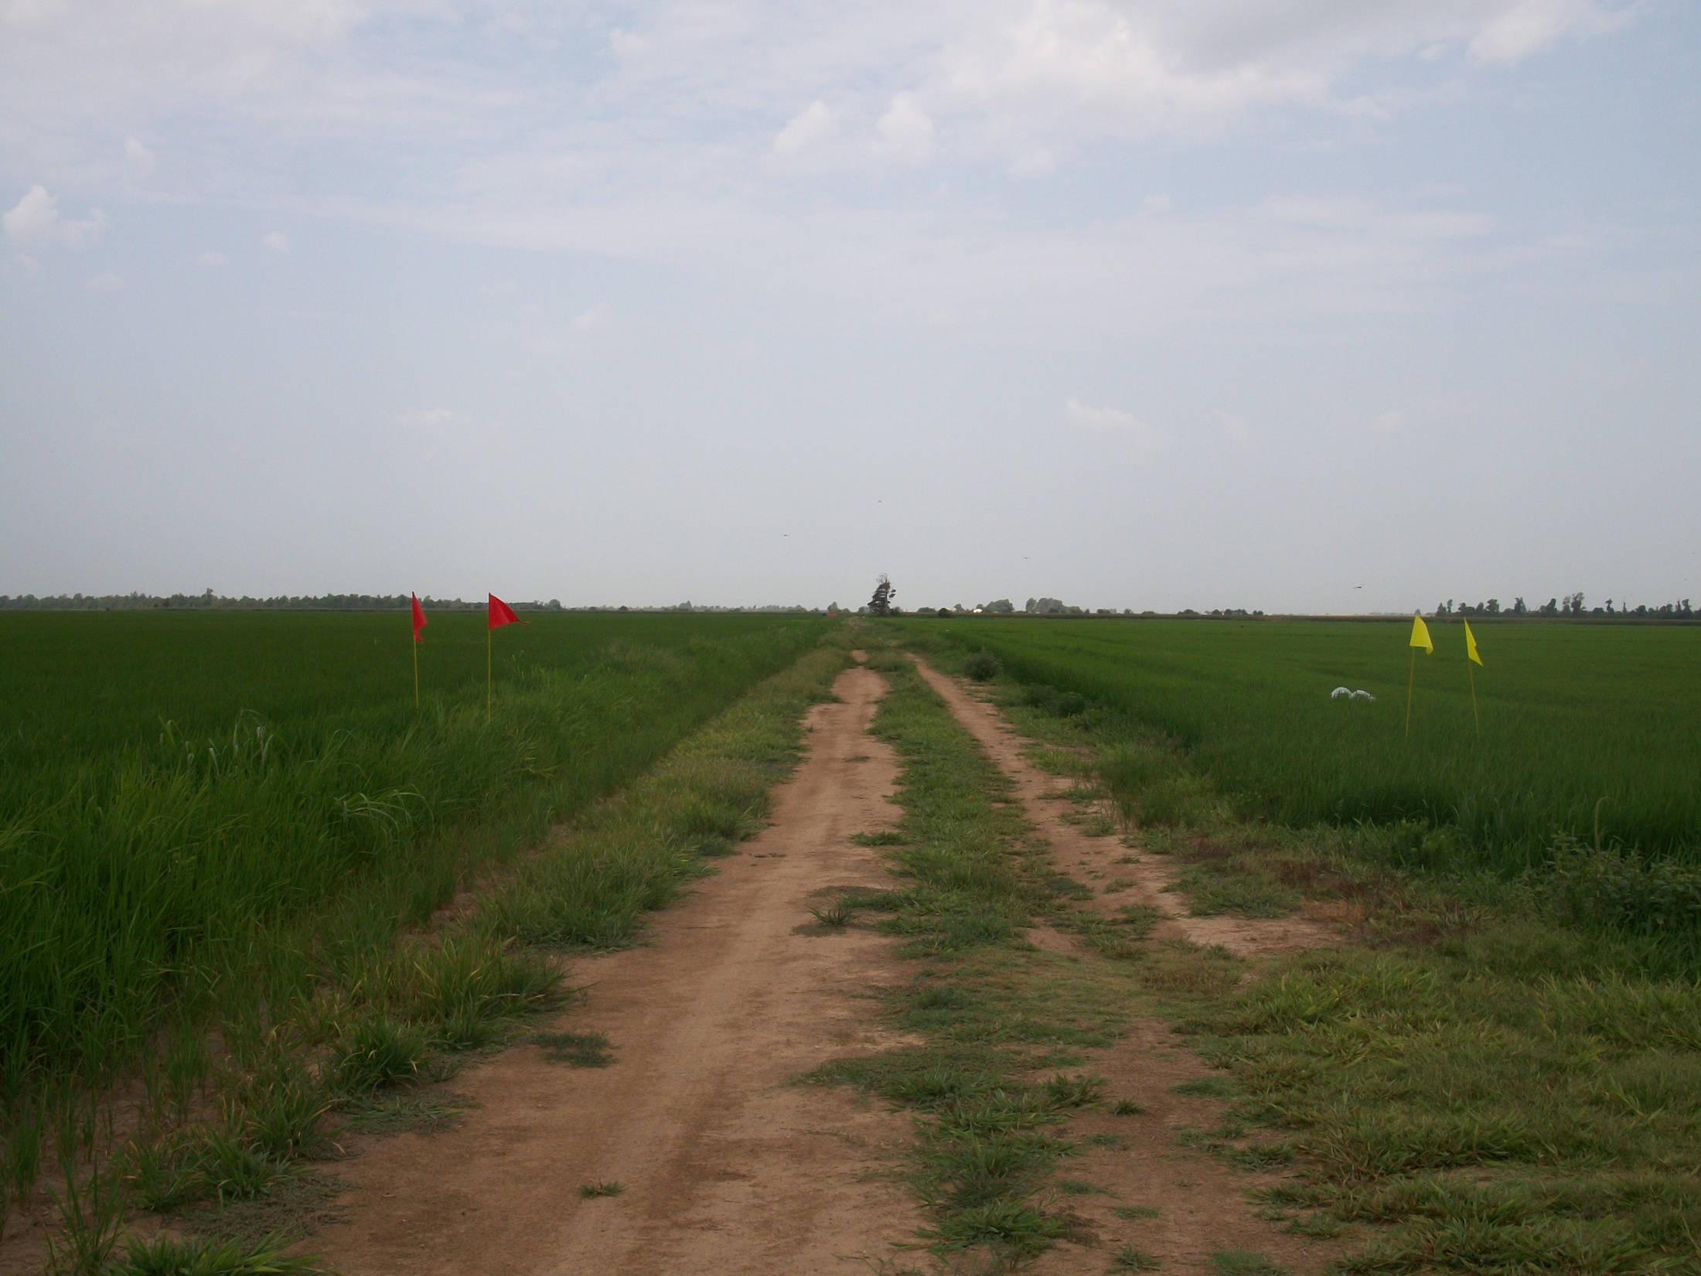
Flag The Technology
A simple way to mark the herbicide technology of any field.
RED signifies conventional crops with no herbicide technology traits.
BRIGHT YELLOW is for Clearfield® and STS® technologies.
WHITE represents crops with the RoundUp Ready® technology.
BRIGHT GREEN indicates the Liberty Link® technology.

Slide 6
Fact Sheets
Dash Stickers

Slide 7
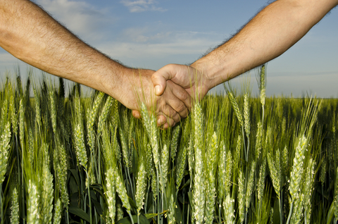
Fewer mistakes can help a farmer stay in business and also stay on the good side of his neighbor…
…and that’s better for everyone.

Slide 8
http://www.uaex.edu/

Slide 9
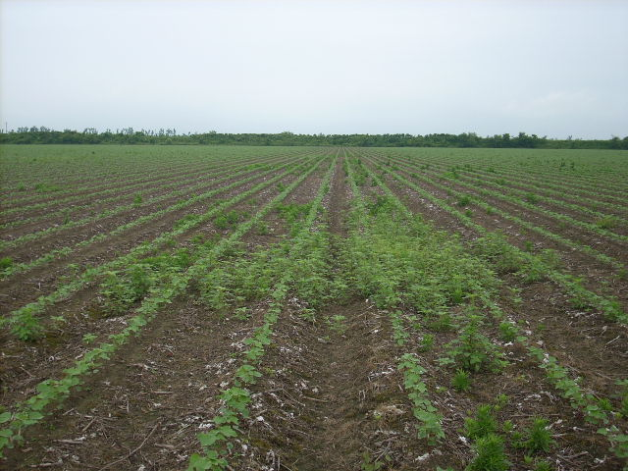

Slide 10
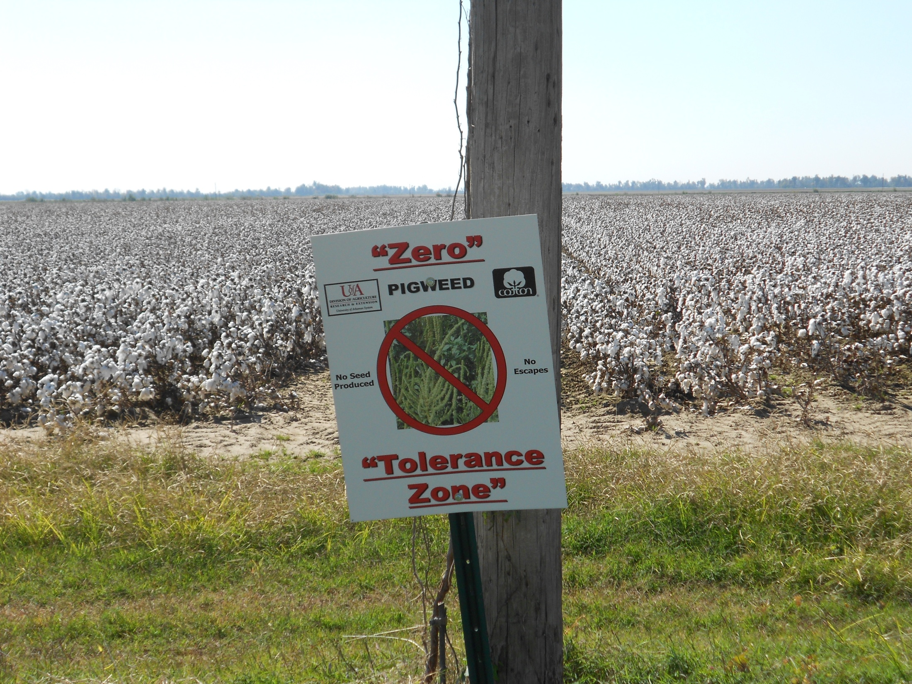

Slide 11
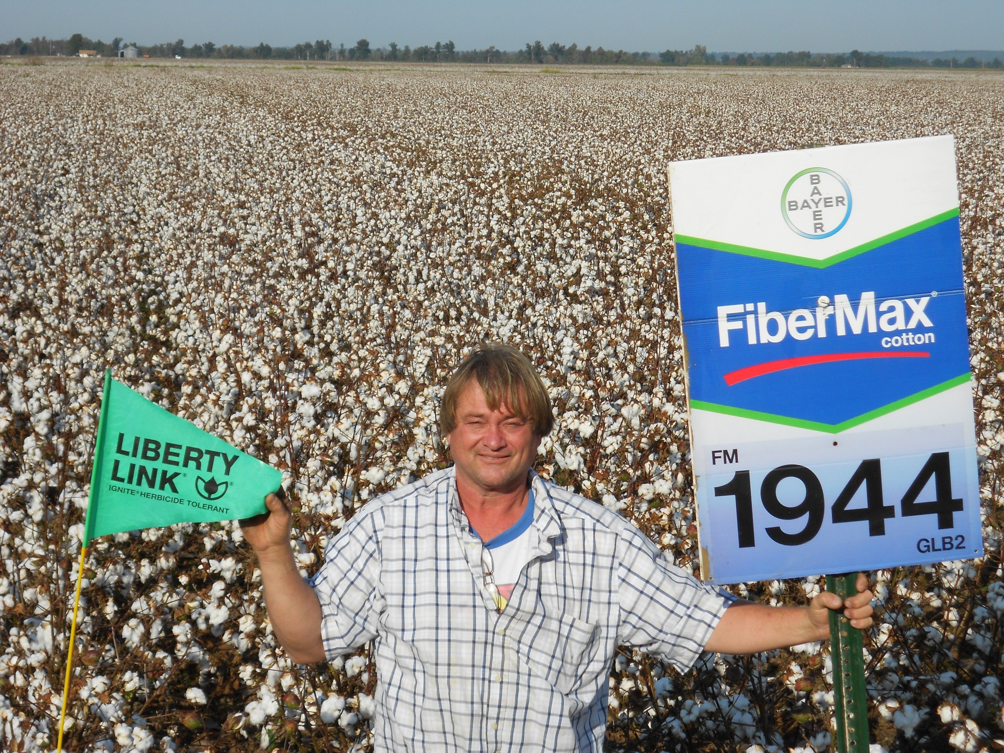

Slide 12
Where do we go from here?
Multiple Colors for Stacked Herbicide Traits
FTT Mapping Apps for Mobile Devices
Applicators Synchronized with FTT Apps

Slide 13
Questions?

